Slide 1

OOP PROJECT

Slide 2
Used SFML(simple and fast multimedia library)
SFML, the Simple and Fast Multimedia Library, is a powerful C++ framework designed to facilitate the development of multimedia applications and games. With SFML, developers can easily handle graphics rendering, audio playback, input handling, and even networking functionalities, all within a clean and intuitive API. SFML's cross-platform nature ensures that projects can be deployed seamlessly across various operating systems, including Windows, macOS, and Linux. Whether you're a seasoned game developer or just starting out in the world of multimedia programming, SFML offers a user-friendly environment to bring your creative visions to life.

Slide 3
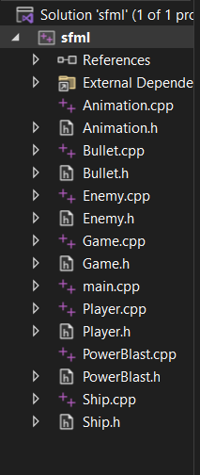
Classes and header files hierarchy

Slide 4
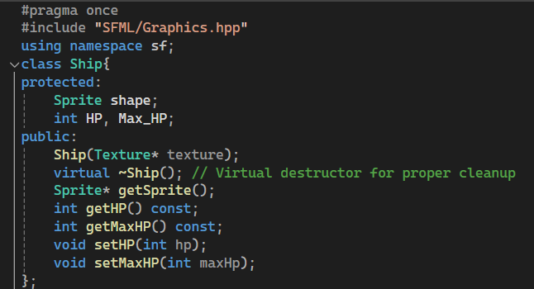
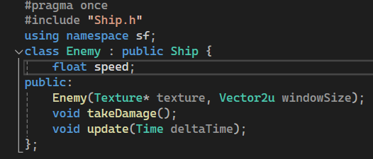
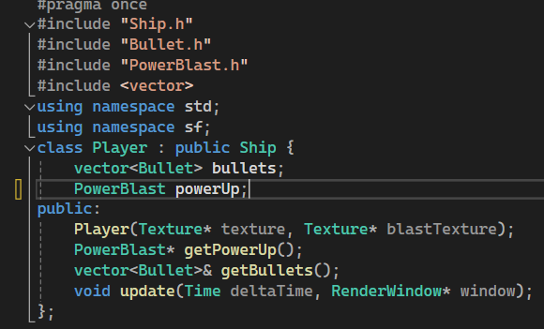
Along with encapsulation, we used inheritance in our project. Since the player and enemy are both Spaceships that use common functions, we made a parent Ship class that has the getters and setters for HP & MaxHP as well as a constructor that takes a pointer to Texture that sets the Texture for the player & enemy ship Sprites

Slide 5
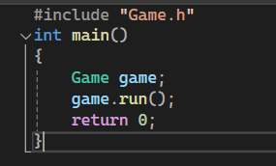
MAIN FILE
main.cpp has only the game.h header file included as all the other files are included there and this makes the more modularized and divided into components rather than the code being in one page. This helped us to work simultaneously on different things.

Slide 6
game.h and game.cpp
Text files, sound file, texture files(images), UI, all are initialized here
Title music, Background music, Bullet and blaster sounds upon firing are all played when the respective conditions like key presses are fulfilled.
Player spacecraft movement based on W,A,S,D key movements is defined here.
Player spacecraft thruster animation is implemented here
Logic of bullets collision with enemy spacecraft is implemented here with each enemy spacecraft only capable of taking 3 hits before getting destroyed.
Enemy respawn times and positions are defined here.
All graphical elements are then rendered here
In case of text fonts are not loading exception handling is also done

Slide 7
Ship.h and Ship.cpp files
Ship sprite is getting a texture from a image asset saved in the same directory as the code.
The current health and max health variables of the ship are initialized with their getter setter functions.
In the header file the ship class is defined with all of its data members and methods.
The Ship class acts as a parent class to the Player and Enemy classes

Slide 8
Enemy.h and Enemy.cpp files
Enemy.h file has the definition of the enemy class with inheritance from the ship class.
The constructor and the relevant data member are defined.
Since function prototyping was done in Enemy.h so the implementation of those functions is done in Enemy.cpp.

Slide 9
Bullet.h and Bullet.cpp files
Bullet.h has the bullet class defined where its sprite has been initialized and provided with a texture and relevant function prototyping has been done as well.
Bullet.cpp has all the function implementations of the prototyped functions.

Slide 10
Powerblast.h and Powerblast.cpp fles
Powerblast.h file has the powerblast class definition with its sprite initialization and providing it a texture. In addition relevant function prototyping Is also done and a constructor is also defined.

Slide 11
Player.h and Player.cpp files
Player.h file has the player class defined which is inheriting form the ship class. It has a array of vector bullets and a power blast as the data member to implement its weapons systems.
It also has the relevant function prototyping.
All the protyped function have their implementation in the Player.cpp file

Slide 12
animation.h and animation.cpp
Animation.h file is using a sprite sheet from the image assets in the project folder and only selecting its top most row and displaying separate images every second to create a thruster animation for the Player spacecraft.
The animation default and parameterized constructors are defined over here as well.

Slide 13
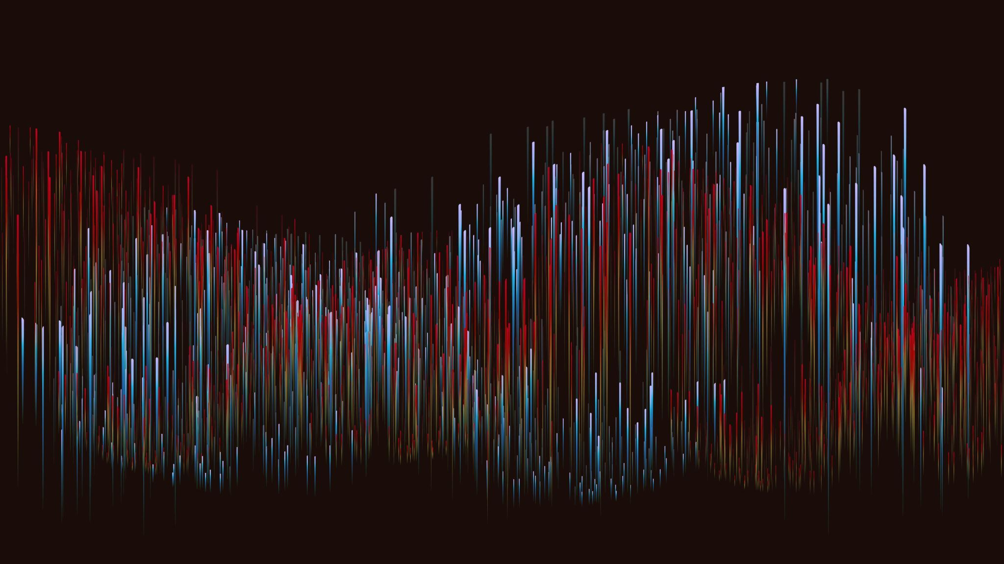
Thank you BS(AI) 2-A SYED UKKASHAH [23K-0055] IBRAHIM JOHAR [23K-0074] MUHAMMAD ABBAS [23K-0068]

